Slide 1

Olessia Bauer
July 2, 2026

Slide 2


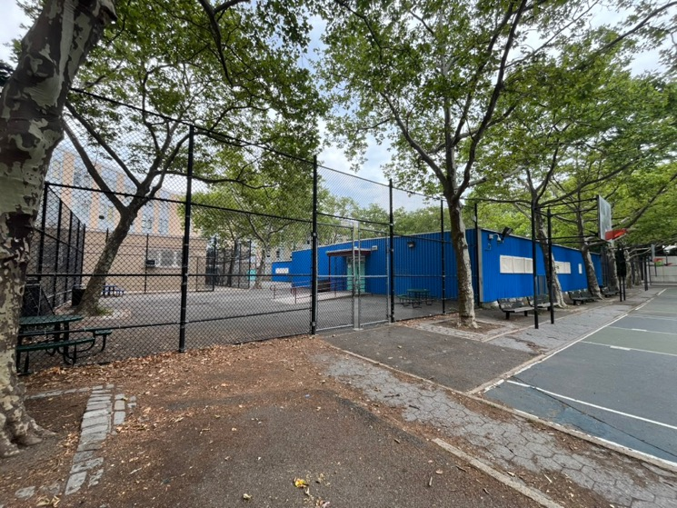
M.S. 217
Olessia.bauer.cec28@gmail.com
An Annex will be built!!!

Slide 3
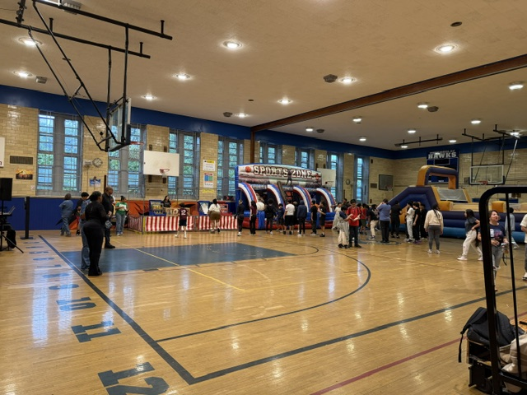
Summer Rising at M.S 217
Olessia.bauer.cec28@gmail.com

Slide 4

Olessia.bauer.cec28@gmail.com
No updates

Slide 5

J.H.S 157 (last update)
Olessia.bauer.cec28@gmail.com
A/C window units are installed in the auditorium
Construction is ongoing of 3 classrooms
Orientation for incoming 6th graders is scheduled on August 7th over Zoom

Slide 6
New liaison schools
P.S. 182
P.S. 139
Q167 (MELS) –visit scheduled on 9/16/2026

